Slide 1
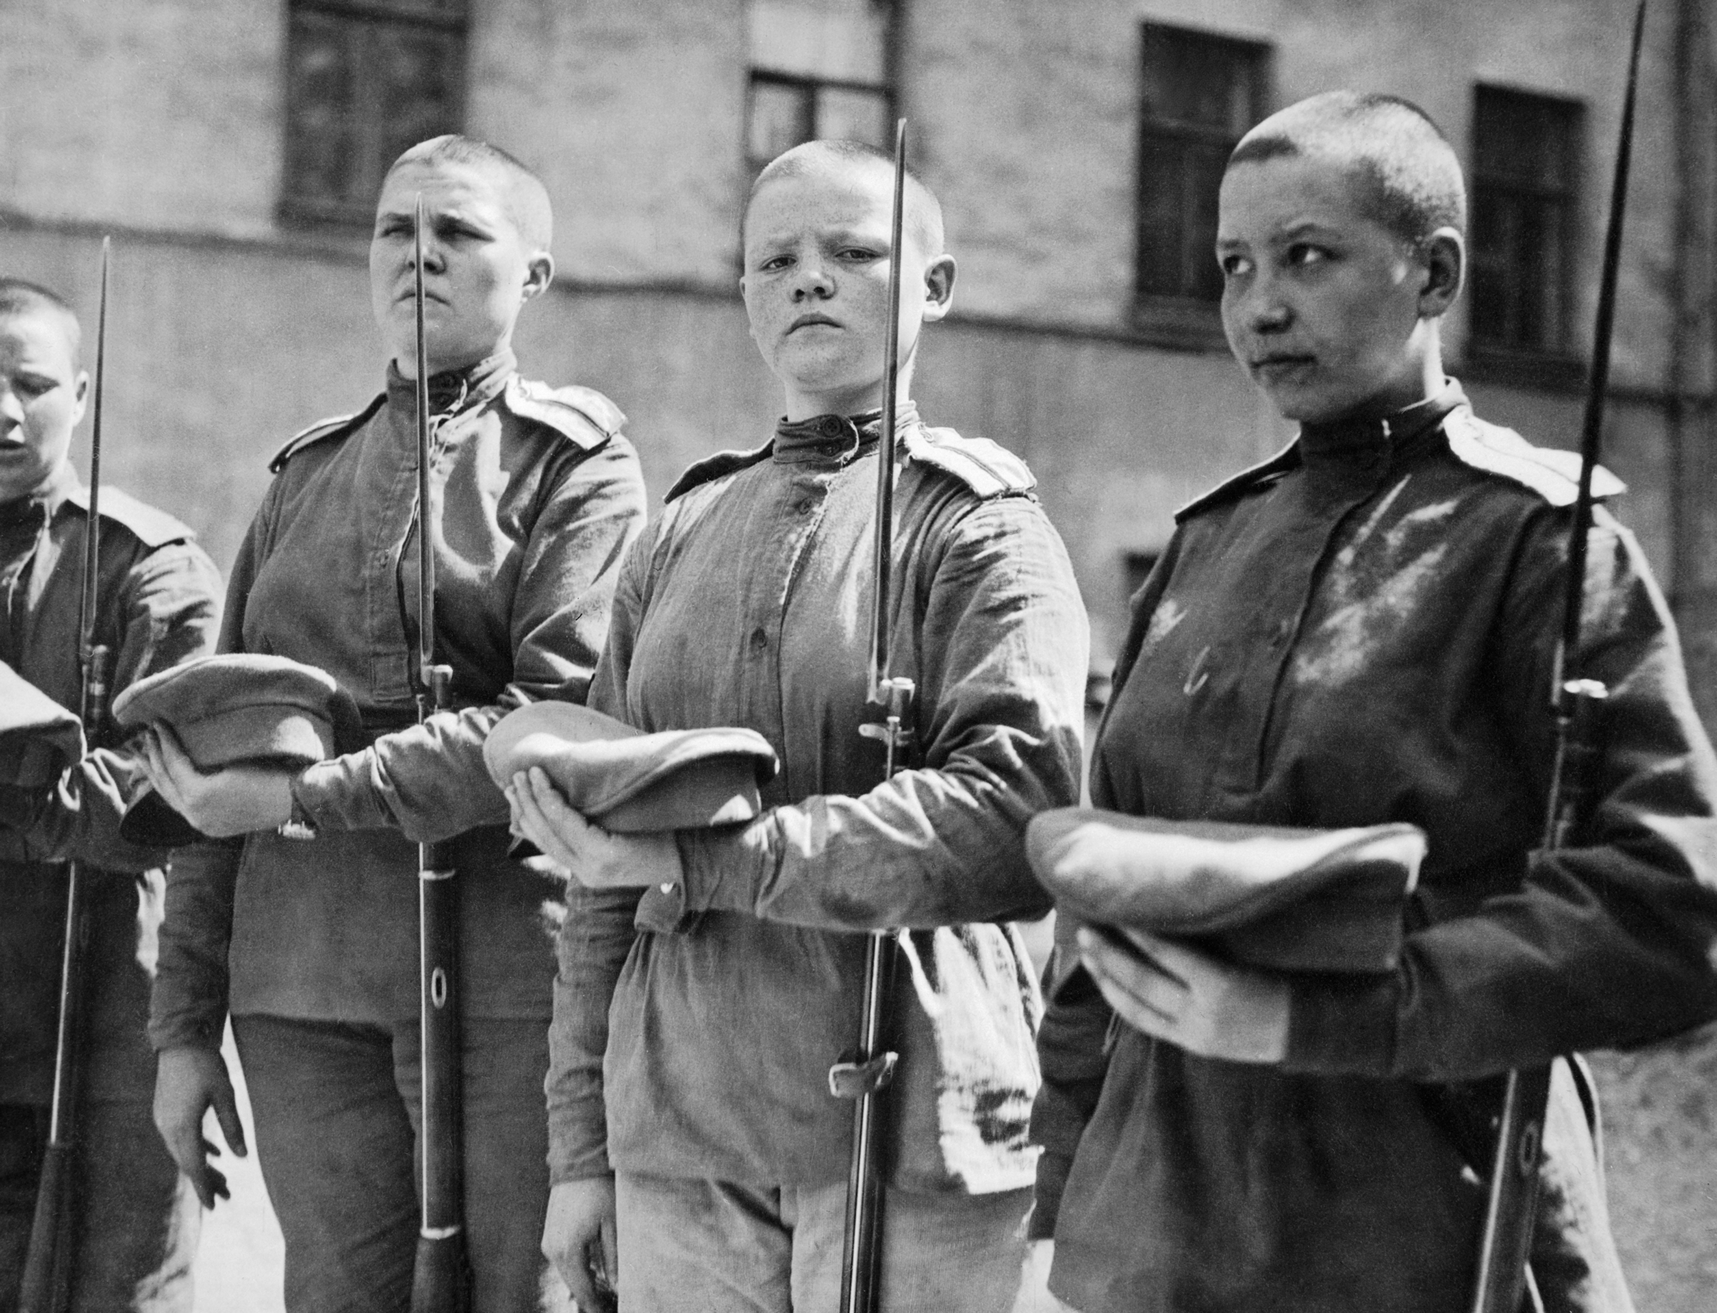
Awareness
Connecting with young people, ensuring that the War
is remembered and commemorated in another hundred years’ time
© Crown Copyright IWM.

Slide 2
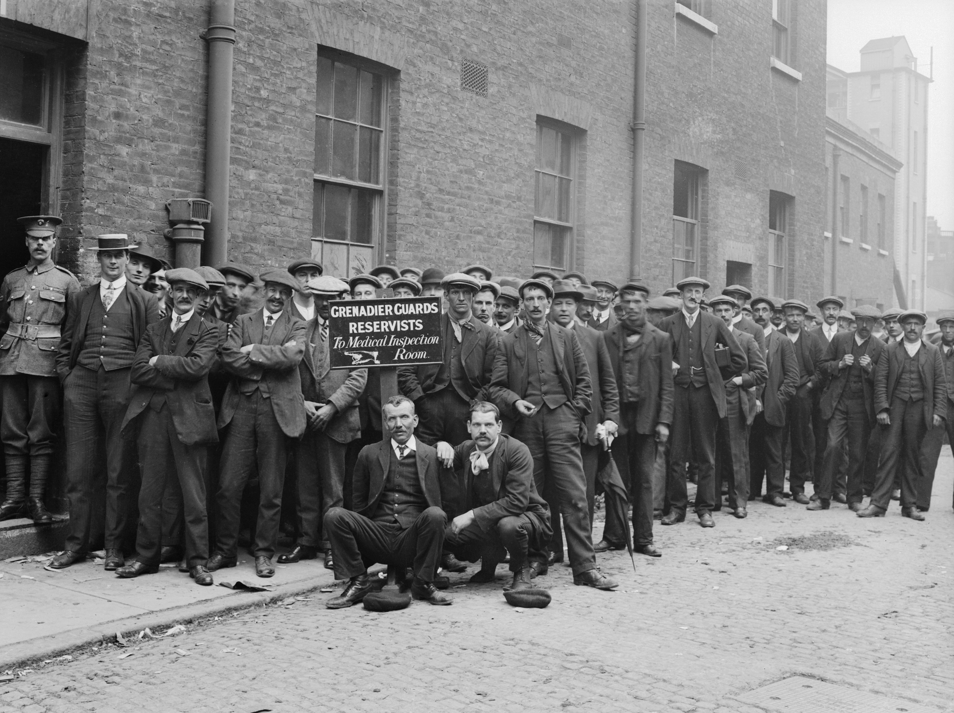
Engagement
Enabling people to learn and understand more about the War: why it started, what happened, and most importantly, how the conflict shaped the world we live in today
© Crown Copyright IWM.

Slide 3
Working with
Department for
Communities and
Local Government
Foreign &
Commonwealth
Office
Department
for Education
Ministry
of Defence

Slide 4
The Government Programme
National Events
Cultural Programme
Education Programme
Community Programme
International Engagement

Slide 5
National
Events
National Commemorative Events 2014
Entry of British Empire into the War
4 August
Commonwealth Commemoration, Glasgow Cathedral
Ceremony at St Symphorien Cemetery, Belgium
Evening Candlelit Vigil, Westminster Abbey
National Commemorative Events 2016-18
Gallipoli – April 2015
Jutland – June 2016
Somme – July 2016
Passchendaele – 2017
Armistice – 2018

Slide 6
Cultural
Programme
Transformation of IWM First World War galleries
Cultural Programme: 14-18NOW: a £10m lottery funded programme covering three specific seasons in 2014, 2016 & 2018.

Slide 7
Education
Programme
School Battlefields visits: £5.3m programme to send two pupils from secondary schools in England to the Western Front – pilots completed. Scheduled for Spring 2014 launch

Slide 8
Community
Programme
Community Commemorations: Centenary Apprenticeships, and VC Paving Stones
HLF Open Grants programme
War Memorials: funding available for conservation, repair and research

Slide 9
International
Engagement
To ensure appropriate international representation in the UK & Overseas
To support commemorative activity overseas

Slide 10
Devolved
Administrations
Scottish Government
Welsh Government
Northern Ireland Executive

Slide 11
Funding
&
Support
Arts Council England
Dedicated website on Gov.uk and open source brand available for download by non-commercial organisations
HLF – groups, communities and organisations
IWM Centenary Partnership – network of 1,400 local, regional, national and international cultural organisations

Slide 12
Governance
Secretary of State for Culture, Media and Sport
Minister of State, DCMS
Prime Minister’s Special Representative
Advisory Group – Chair, Secretary of State for Culture, Media and Sport
Inter-Departmental Government Programme Board – Chair DCMS

